Slide 1

MERN Stack Powered By Mongodb
AppointDoc Application Using MERN Stack
Swetha E S
Swetha G
Newlyn Kiruba J
Harris Joshua

Slide 2
Problem Statement
In today’s fast-paced world, managing doctor appointments efficiently is crucial for both patients and healthcare professionals.
For Patients: Patients need an easy-to-use system to browse through available doctors, view their availability, and book appointments seamlessly.
For Doctors: Doctors require a platform to manage their schedules, update their availability, and handle appointments, including the ability to approve or cancel them as needed.
The challenge lies in building a scalable, user-friendly, and maintainable system that simplifies appointment booking and schedule management for both parties.

Slide 3
Solution Proposed
Backend Development: Build a RESTful API using Node.js and Express.js to handle CRUD operations, authentication with JWT, and secure password storage with bcrypt.
Database Management: Use MongoDB for storing patient, doctor, and appointment details, and Mongoose for schema validation and efficient database operations.
Frontend Development: Create a responsive UI with React, enabling patients to book appointments and doctors to manage schedules, using Redux Toolkit for state management.
Scalability and Security: Structure the application modularly for scalability, secure data transfer with cors, and ensure real-time updates with a robust notification system.

Slide 4
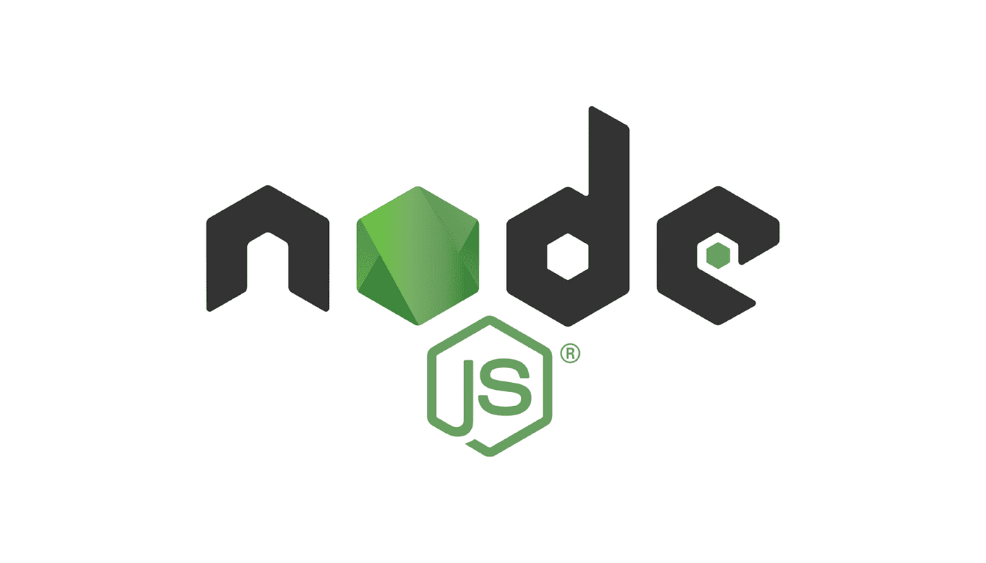

Tech Stack
MongoDB: NoSQL database for storing patient, doctor, and appointment data.
Express.js: Backend framework for building RESTful APIs and handling server-side logic.
React: Frontend library for creating interactive and responsive user interfaces.
Node.js: JavaScript runtime environment for building scalable server-side applications.

Slide 5
Reason For Choosing These Technologies
MongoDB: Its flexible NoSQL schema makes it ideal for handling dynamic and scalable data like appointments and user profiles.
Express.js: Simplifies backend development with robust routing and middleware capabilities.
React: Provides a dynamic and interactive user interface with a component-based architecture.
Node.js: Offers a fast, scalable environment for building real-time, server-side applications.

Slide 6
Benefits
Scalability: Easily handles growing user and appointment data with MongoDB’s flexible schema.
Efficiency: Streamlined development with Express.js and React ensures quick and responsive operations.
Security: User authentication with JWT and secure password storage using bcrypt enhances application security.
User Experience: React’s interactive UI delivers a seamless experience for both patients and doctors.

Slide 7
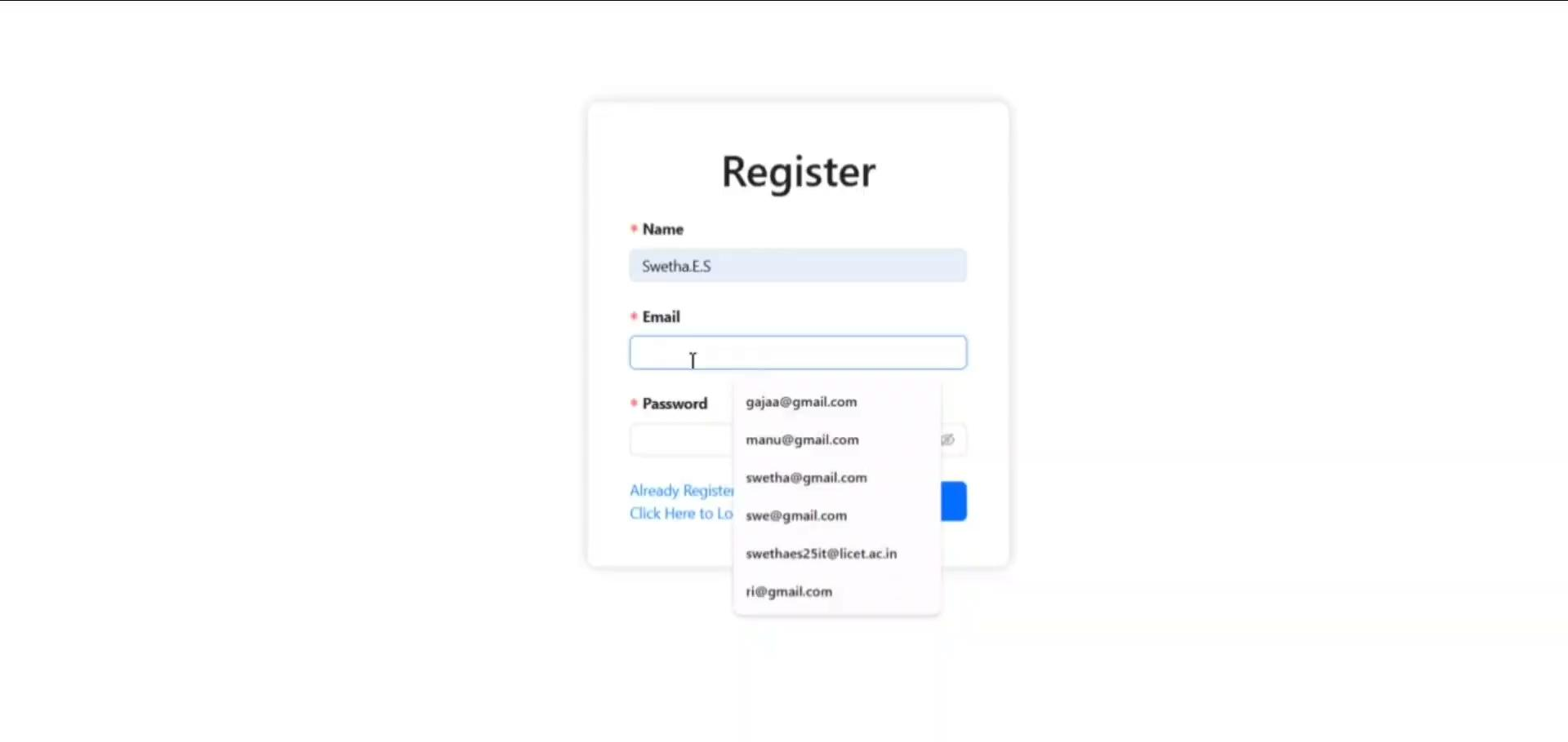
DEMO

Slide 8
Thank You

